Slide 1
Fake News, the Tail Wags the Dog?
Has Fake News inspired legislation?
Justin Whitlock

Slide 2
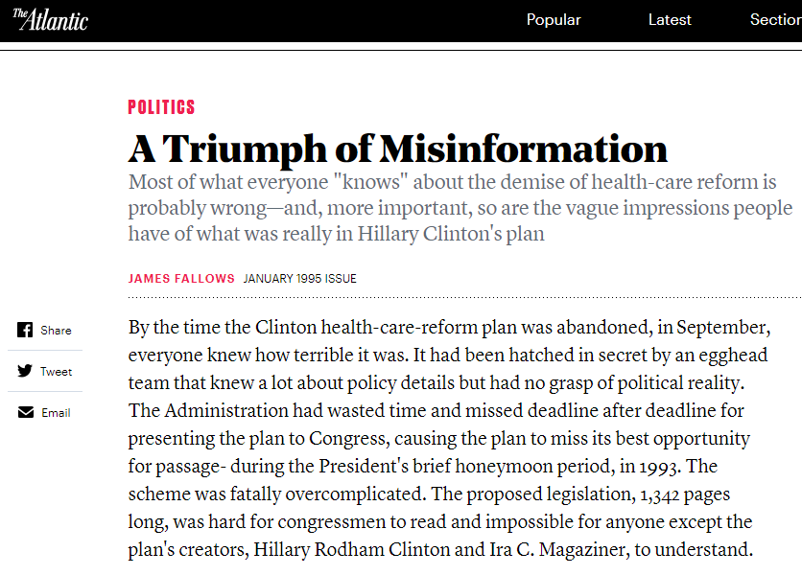
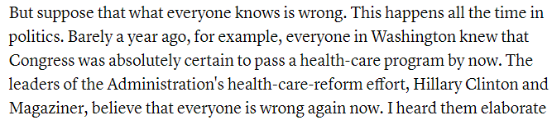
Has fake news had an impact on legislation?
https://www.theatlantic.com/magazine/archive/1995/01/a-triumph-of-misinformation/306231/

Slide 3
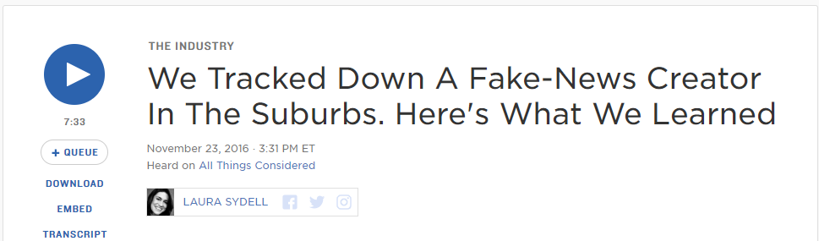
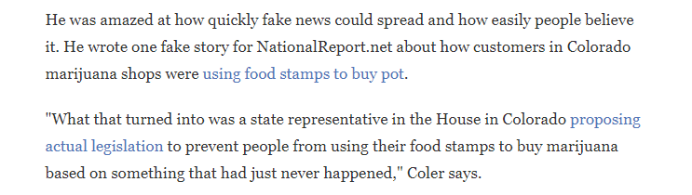
Fake News Peddler Claims Undue Influence, 2016
https://www.npr.org/sections/alltechconsidered/2016/11/23/503146770/npr-finds-the-head-of-a-covert-fake-news-operation-in-the-suburbs

Slide 4
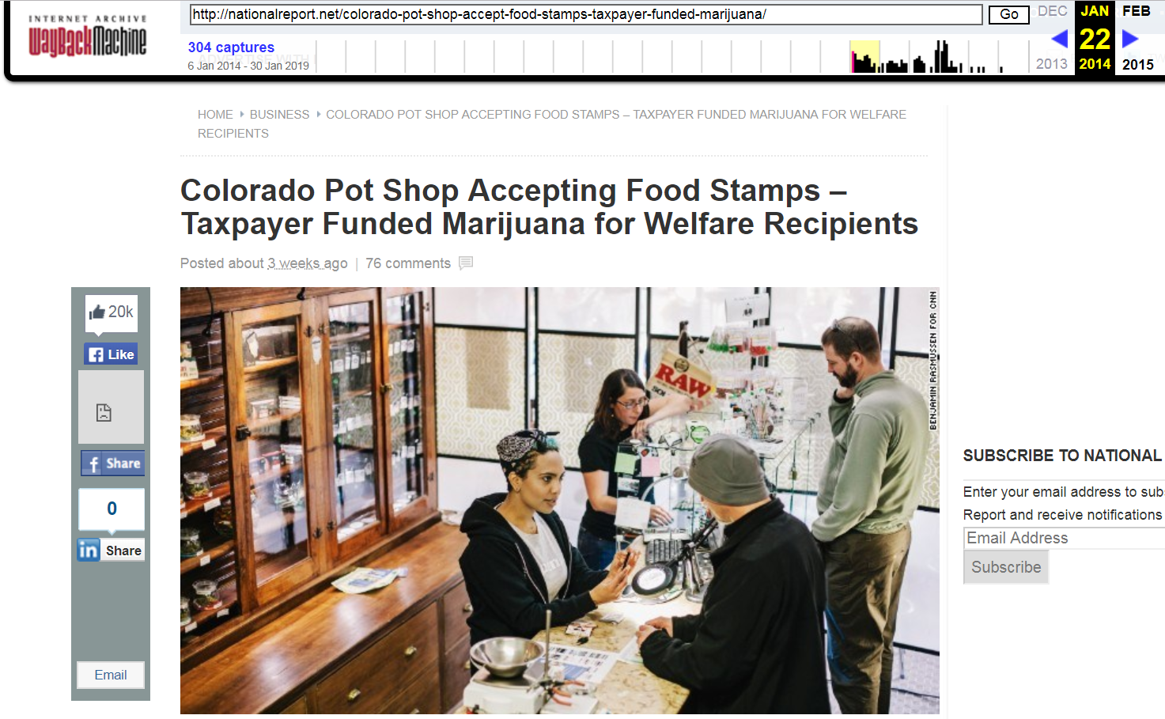
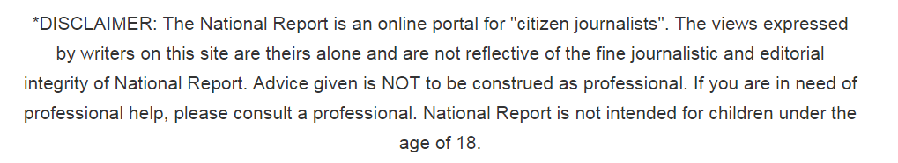
Original Article: NationalReport.net Captured 22 Jan 14,
posted 3 weeks prior
https://web.archive.org/web/20140122053240/http://nationalreport.net/colorado-pot-shop-accept-food-stamps-taxpayer-funded-marijuana/

Slide 5
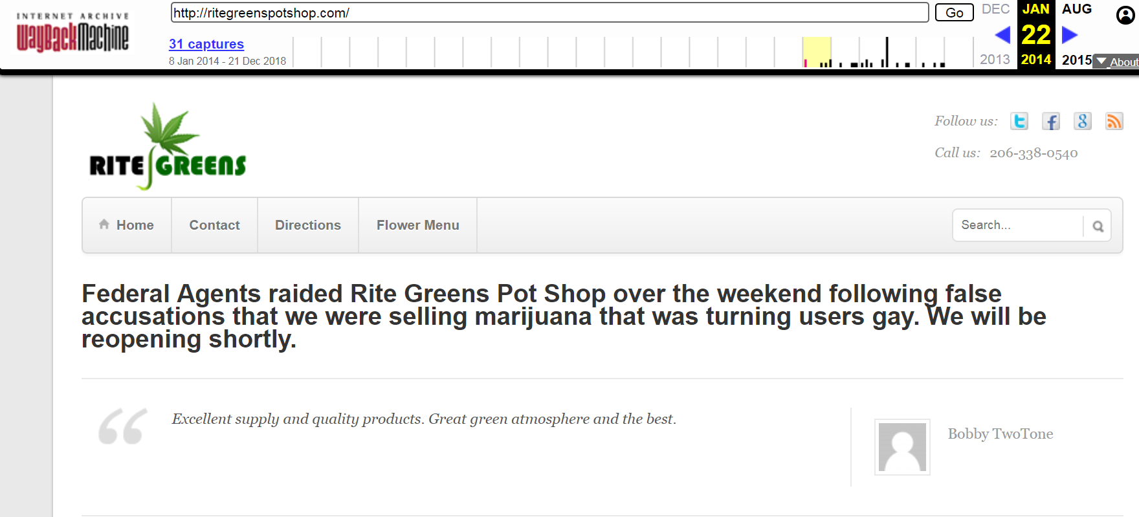
Includes a link to a Fake Pot Dispensary
https://web.archive.org/web/20140122120630/http://ritegreenspotshop.com/

Slide 6
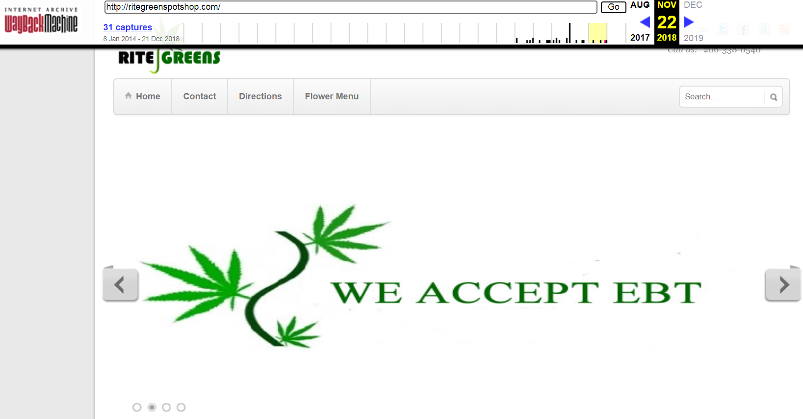
Still up in 2018, Now with scrolling photos!
https://web.archive.org/web/20181122140325/http://ritegreenspotshop.com/

Slide 7
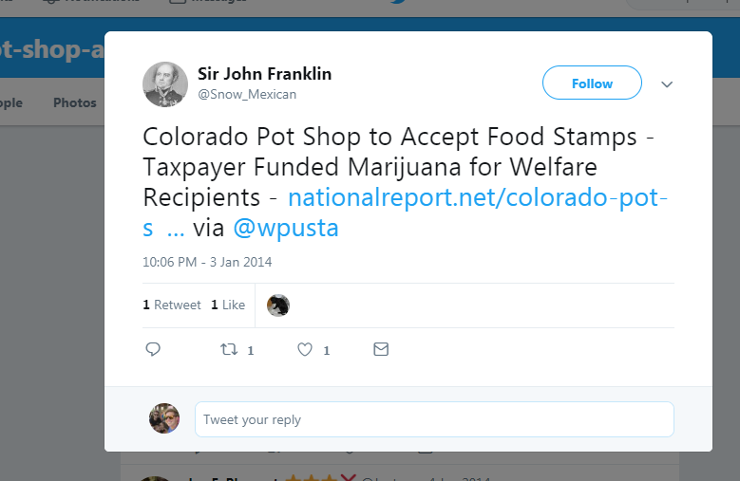
Carbon Dating Nat. Report Birthday 03 January 2014
http://nationalreport.net/colorado-pot-shop-accept-food-stamps-taxpayer-funded-marijuana/
http://carbondate.cs.odu.edu/#http://nationalreport.net/colorado-pot-shop-accept-food-stamps-taxpayer-funded-marijuana/
https://twitter.com/Snow_Mexican/status/419349095417790464
{ "self": "http://carbondate.cs.odu.edu/cd/http://nationalreport.net/colorado-pot-shop-accept-food-stamps-taxpayer-funded-marijuana/", "uri": "http://nationalreport.net/colorado-pot-shop-accept-food-stamps-taxpayer-funded-marijuana/", "estimated-creation-date": "2014-01-03T22:05:55", "earliest-sources": [ "web.archive.org", "wayback.archive-it.org" ], "sources": { "web.archive.org": { "uri-m": "http://web.archive.org/web/20140106030044/http://nationalreport.net:80/colorado-pot-shop-accept-food-stamps-taxpayer-funded-marijuana/", "memento-datetime": "2014-01-06T03:00:44", "memento-pubdate": "2014-01-03T22:05:55", "earliest": "2014-01-03T22:05:55" }, "wayback.archive-it.org": { "uri-m": "http://wayback.archive-it.org/all/20161119220529/http://nationalreport.net/colorado-pot-shop-accept-food-stamps-taxpayer-funded-marijuana/", "memento-datetime": "2016-11-19T22:05:29", "memento-pubdate": "2014-01-03T22:05:55", "earliest": "2014-01-03T22:05:55" }, "archive.md": { "uri-m": "http://archive.md/20161125001036/http://nationalreport.net/colorado-pot-shop-accept-food-stamps-taxpayer-funded-marijuana/", "memento-datetime": "2016-11-25T00:10:36", "memento-pubdate": "2016-11-25T00:10:36", "earliest": "2016-11-25T00:10:36" },
"bing.com": { "earliest": "" }, "bitly.com": { "earliest": "2014-01-04T06:12:13" }, "google.com": { "earliest": "" }, "last-modified": { "earliest": "" }, "pubdate": { "earliest": "" }, "twitter.com": { "earliest": "" } } }

Slide 8
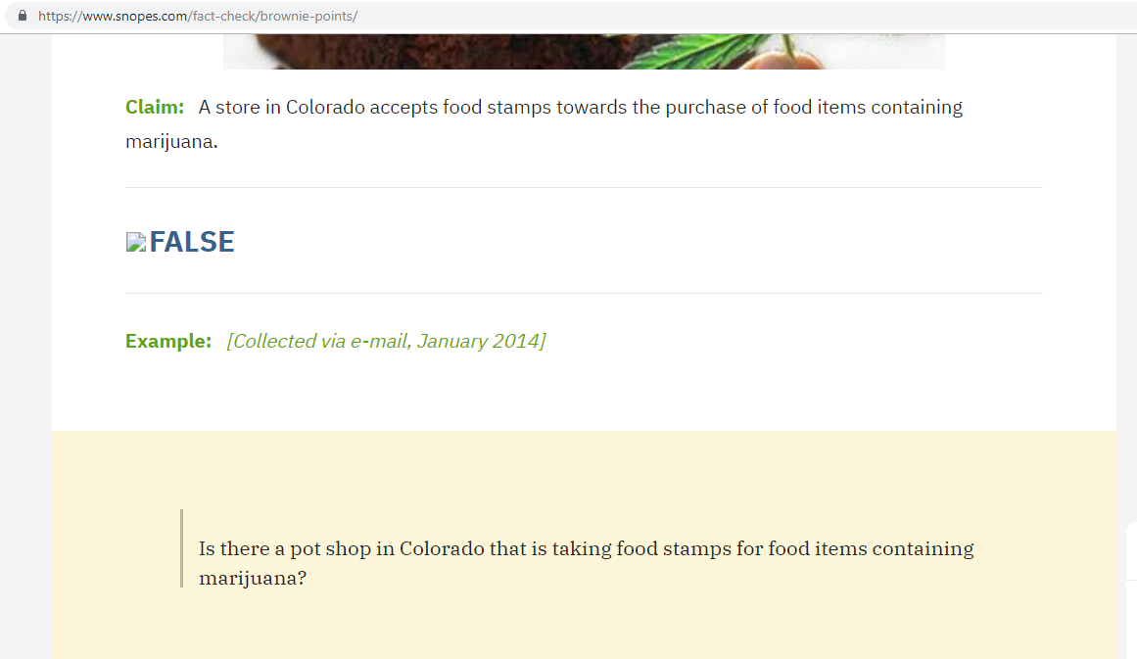
Snopes Immediately Debunks the Article
https://www.snopes.com/fact-check/brownie-points/

Slide 9
Carbon Date Snopes Birthday 03 January 14
{ "self": "http://carbondate.cs.odu.edu/cd/https://www.snopes.com/fact-check/brownie-points/", "uri": "https://www.snopes.com/fact-check/brownie-points/", "estimated-creation-date": "2014-01-03T23:59:59", "earliest-sources": [ "google.com" ], "sources": { "bing.com": { "earliest": "" }, "bitly.com": { "earliest": "" }, "google.com": { "earliest": "2014-01-03T23:59:59" }, "last-modified": { "earliest": "2019-02-21T19:49:46" }, "pubdate": { "earliest": "" }, "twitter.com": { "earliest": "" } } }
http://carbondate.cs.odu.edu/#https://www.snopes.com/fact-check/brownie-points/

Slide 10
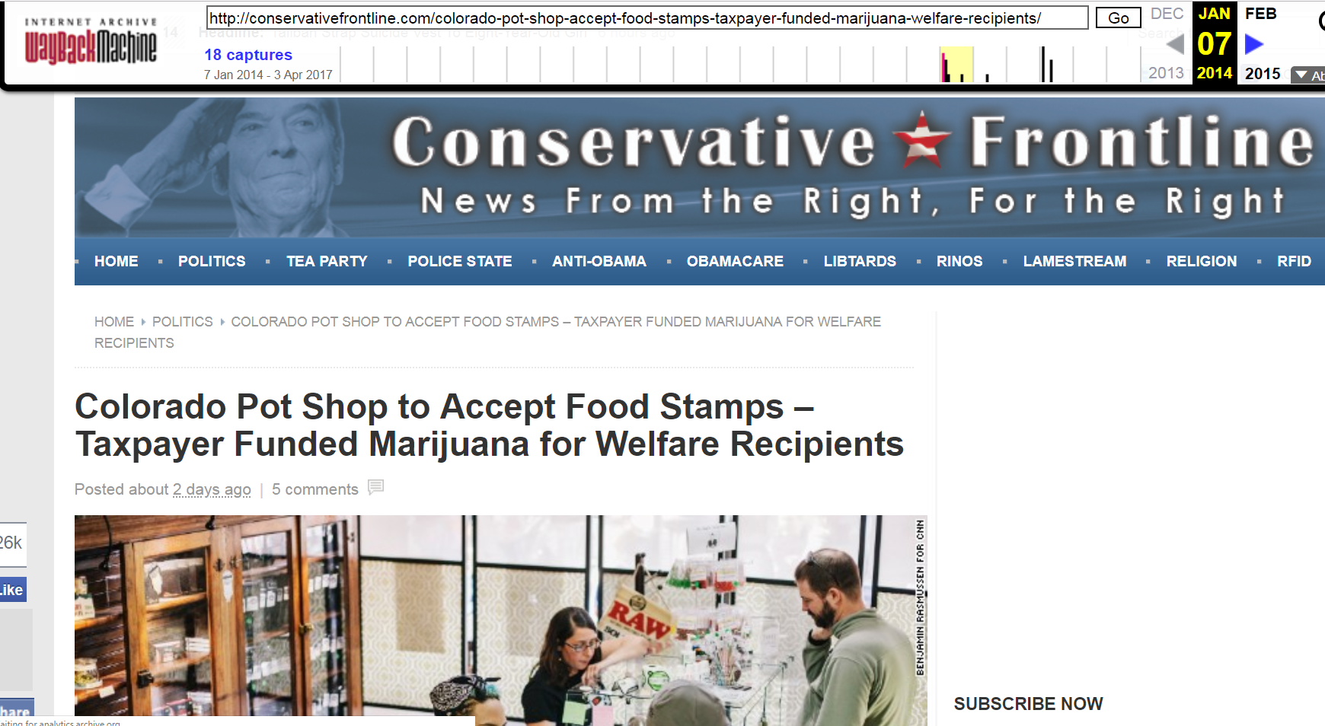
Despite Snopes, Posted without source by Far Right Blog captured 7 Jan 14, posted 2 days prior
https://web.archive.org/web/20140107052915/http://conservativefrontline.com/colorado-pot-shop-accept-food-stamps-taxpayer-funded-marijuana-welfare-recipients/

Slide 11
Carbon Date Conservative Front.. Birthday 04 January 2014
{ "self": "http://carbondate.cs.odu.edu/cd/http://conservativefrontline.com/colorado-pot-shop-accept-food-stamps-taxpayer-funded-marijuana-welfare-recipients/", "uri": "http://conservativefrontline.com/colorado-pot-shop-accept-food-stamps-taxpayer-funded-marijuana-welfare-recipients/", "estimated-creation-date": "2014-01-04T09:39:30", "earliest-sources": [ "web.archive.org" ], "sources": { "web.archive.org": { "uri-m": "http://web.archive.org/web/20140107052915/http://conservativefrontline.com:80/colorado-pot-shop-accept-food-stamps-taxpayer-funded-marijuana-welfare-recipients/", "memento-datetime": "2014-01-07T05:29:15", "memento-pubdate": "2014-01-04T09:39:30", "earliest": "2014-01-04T09:39:30" }, "archive.md": { "uri-m": "http://archive.md/20161125001554/http://conservativefrontline.com/colorado-pot-shop-accept-food-stamps-taxpayer-funded-marijuana-welfare-recipients/", "memento-datetime": "2016-11-25T00:15:54", "memento-pubdate": "2016-11-25T00:15:54", "earliest": "2016-11-25T00:15:54" },
"bing.com": { "earliest": "" }, "bitly.com": { "earliest": "2014-01-04T20:11:18" }, "google.com": { "earliest": "" }, "last-modified": { "earliest": "" }, "pubdate": { "earliest": "" }, "twitter.com": { "earliest": "" } } }
http://carbondate.cs.odu.edu/#http://conservativefrontline.com/colorado-pot-shop-accept-food-stamps-taxpayer-funded-marijuana-welfare-recipients/

Slide 12
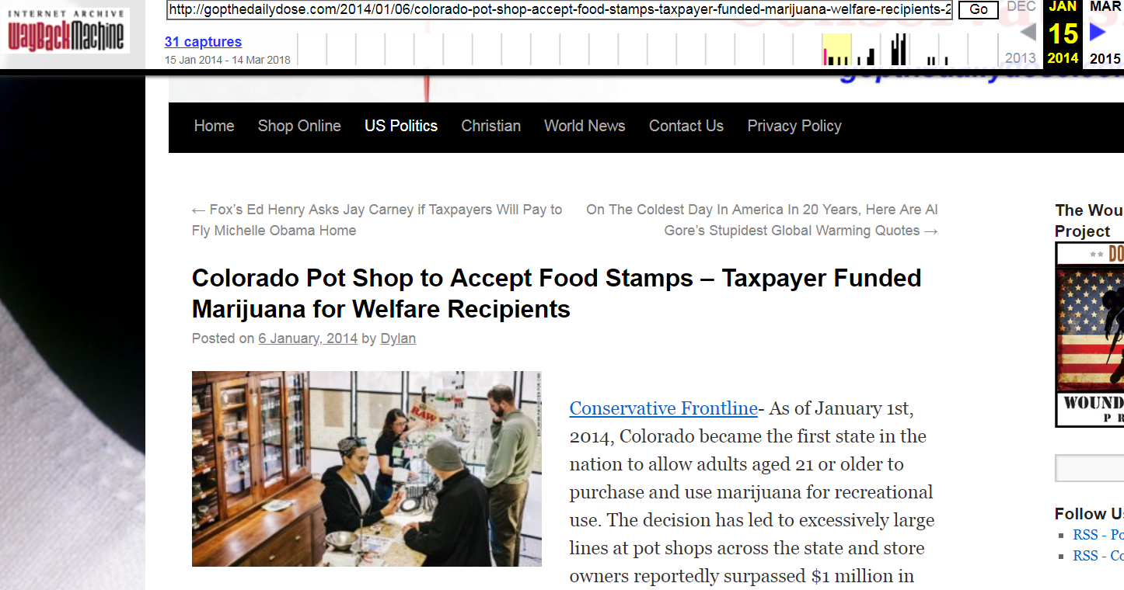
Then Picked up by DailyDose Captured 15 Jan 14,
posted 6 Jan 14
https://web.archive.org/web/20140115052903/http://gopthedailydose.com/2014/01/06/colorado-pot-shop-accept-food-stamps-taxpayer-funded-marijuana-welfare-recipients-2/

Slide 13
Carbon Date Daily Dose Birthday 06 January 14
{ "self": "http://carbondate.cs.odu.edu/cd/http://gopthedailydose.com/2014/01/06/colorado-pot-shop-accept-food-stamps-taxpayer-funded-marijuana-welfare-recipients-2/", "uri": "http://gopthedailydose.com/2014/01/06/colorado-pot-shop-accept-food-stamps-taxpayer-funded-marijuana-welfare-recipients-2/", "estimated-creation-date": "2014-01-06T00:00:00", "earliest-sources": [ "pubdate" ], "sources": { "web.archive.org": { "uri-m": "http://web.archive.org/web/20140115052903/http://gopthedailydose.com:80/2014/01/06/colorado-pot-shop-accept-food-stamps-taxpayer-funded-marijuana-welfare-recipients-2/", "memento-datetime": "2014-01-15T05:29:03", "memento-pubdate": "2014-01-06T21:38:08", "earliest": "2014-01-06T21:38:08" }, "archive.md": { "uri-m": "http://archive.md/20161125001457/http://gopthedailydose.com/2014/01/06/colorado-pot-shop-accept-food-stamps-taxpayer-funded-marijuana-welfare-recipients-2/", "memento-datetime": "2016-11-25T00:14:57", "memento-pubdate": "2016-11-25T00:14:57", "earliest": "2016-11-25T00:14:57" },
"bing.com": { "earliest": "" }, "bitly.com": { "earliest": "2014-01-07T03:30:22" }, "google.com": { "earliest": "" }, "last-modified": { "earliest": "" }, "pubdate": { "earliest": "2014-01-06T00:00:00" }, "twitter.com": { "earliest": "" } } }
http://carbondate.cs.odu.edu/#http://gopthedailydose.com/2014/01/06/colorado-pot-shop-accept-food-stamps-taxpayer-funded-marijuana-welfare-recipients-2/

Slide 14
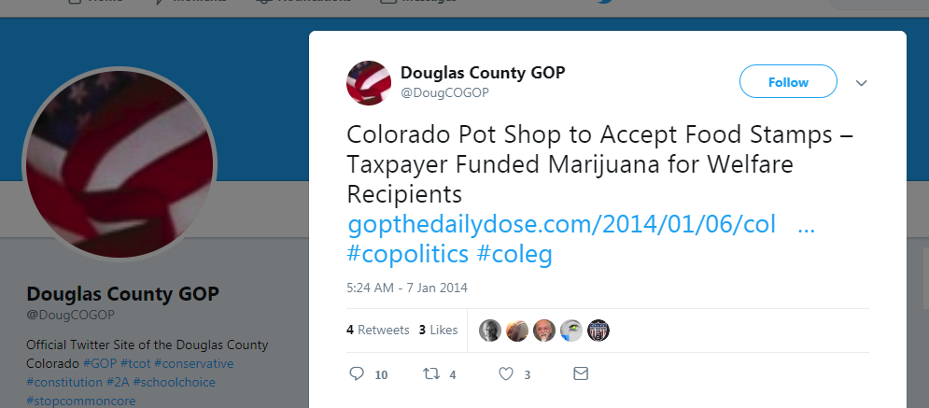
The article was then posted by the local GOP, 7 Jan 2014
https://twitter.com/DougCOGOP/status/420546464331218944

Slide 15
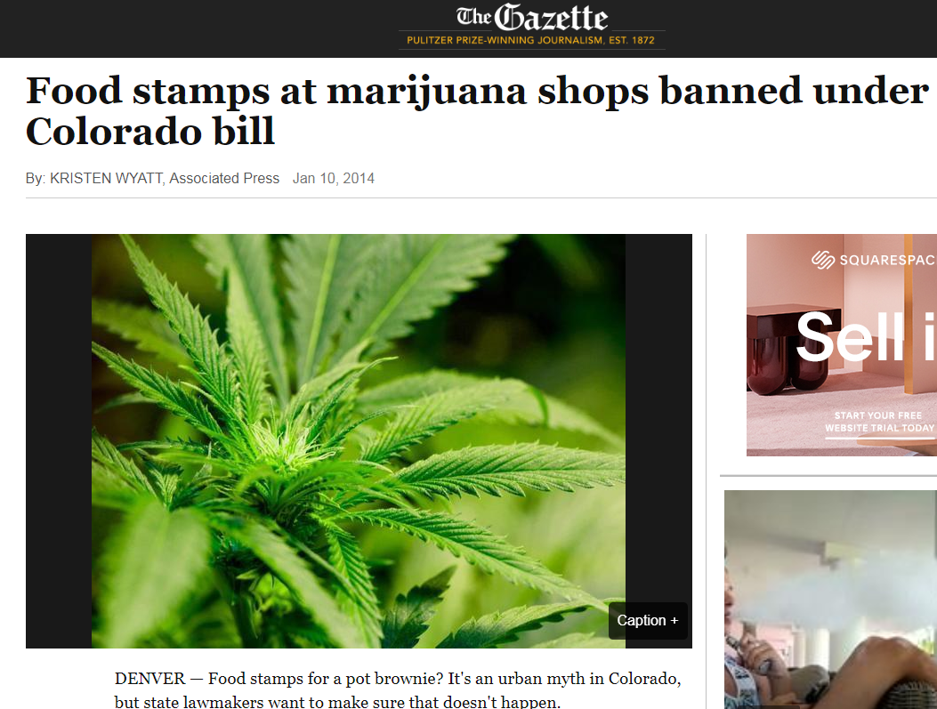
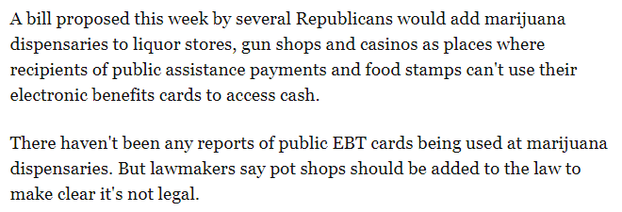
10 Jan 2010, Bill drops to Ban EBT use at Dispensaries
https://gazette.com/news/food-stamps-at-marijuana-shops-banned-under-colorado-bill/article_dfc1511a-7d27-5c4b-97a0-8c20e5f46bb0.html

Slide 16
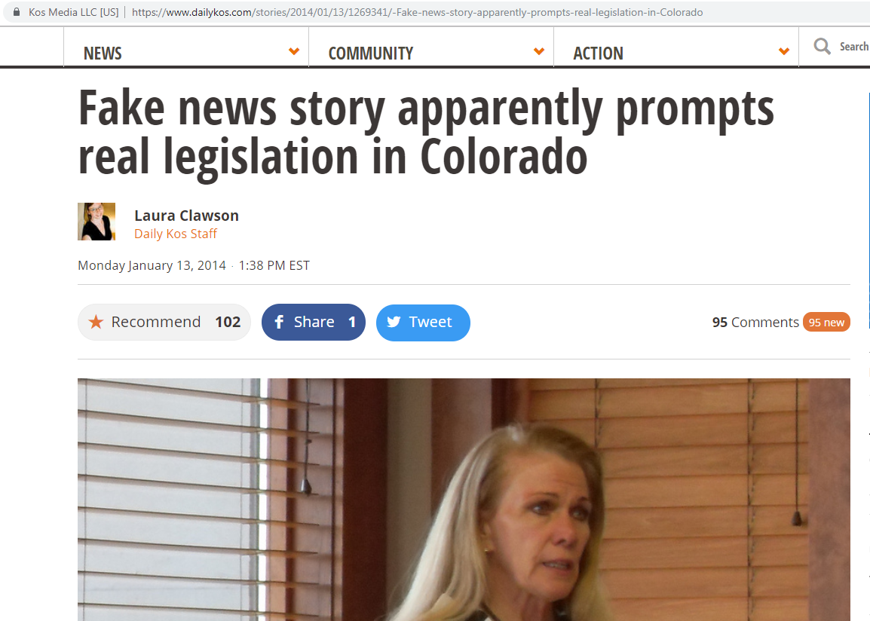
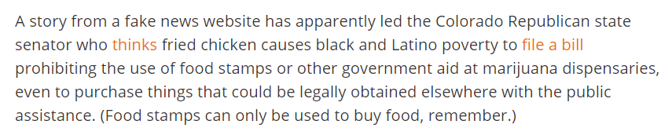
13 Jan, DailyKaos points out the coincidence (trustworthy source?)
https://www.dailykos.com/stories/2014/01/13/1269341/-Fake-news-story-apparently-prompts-real-legislation-in-Colorado

Slide 17
Carbon Date DailyKaos Birthday13 Jan 2014
{ "self": "http://carbondate.cs.odu.edu/cd/https://www.dailykos.com/stories/2014/01/13/1269341/-Fake-news-story-apparently-prompts-real-legislation-in-Colorado", "uri": "https://www.dailykos.com/stories/2014/01/13/1269341/-Fake-news-story-apparently-prompts-real-legislation-in-Colorado", "estimated-creation-date": "2014-01-13T00:00:00", "earliest-sources": [ "pubdate" ], "sources": { "web.archive.org": { "uri-m": "http://web.archive.org/web/20171008060231/http://www.dailykos.com/stories/2014/01/13/1269341/-Fake-news-story-apparently-prompts-real-legislation-in-Colorado", "memento-datetime": "2017-10-08T06:02:31", "memento-pubdate": "2014-01-13T23:59:59", "earliest": "2014-01-13T23:59:59" },
"bing.com": { "earliest": "" }, "bitly.com": { "earliest": "" }, "google.com": { "earliest": "" }, "last-modified": { "earliest": "" }, "pubdate": { "earliest": "2014-01-13T00:00:00" }, "twitter.com": { "earliest": "" } } }
http://carbondate.cs.odu.edu/#https://www.dailykos.com/stories/2014/01/13/1269341/-Fake-news-story-apparently-prompts-real-legislation-in-Colorado

Slide 18
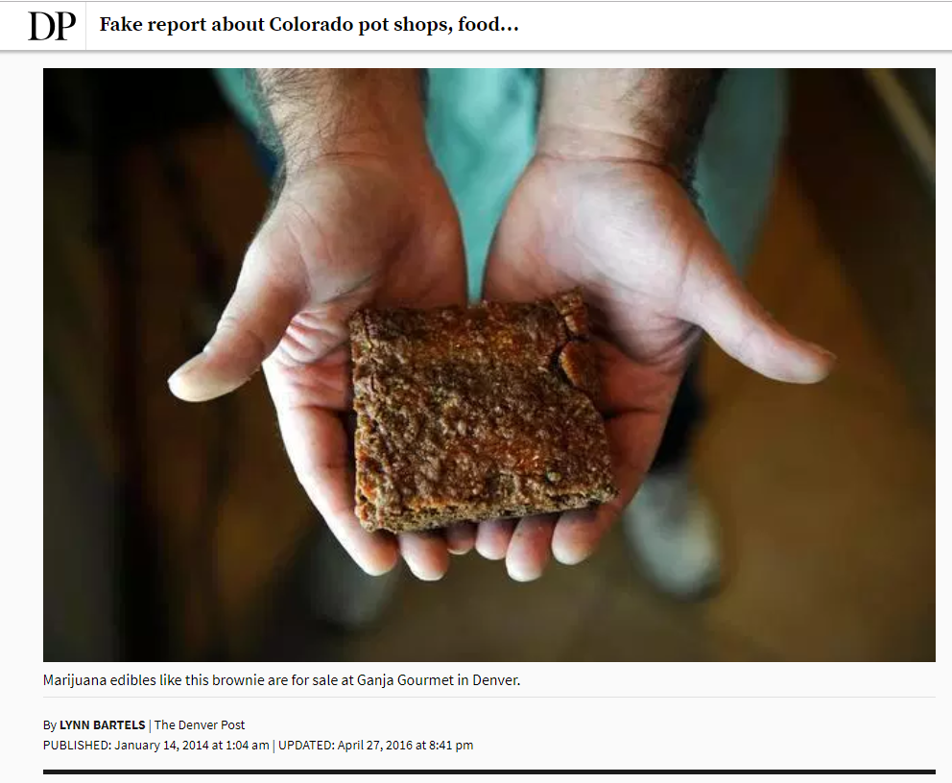
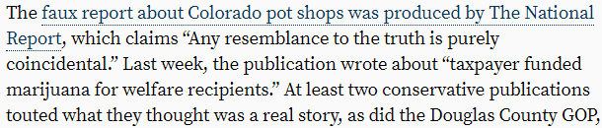
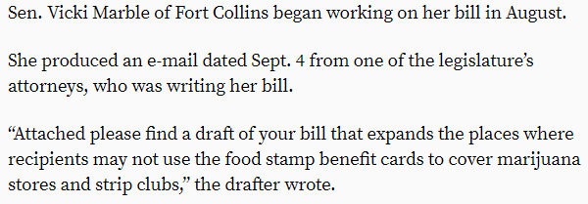
14 January 14, Denver Post Debunks the controversy
https://web.archive.org/web/20161125112436/https://www.denverpost.com/2014/01/14/fake-report-about-colorado-pot-shops-food-stamps-creates-havoc/

Slide 19
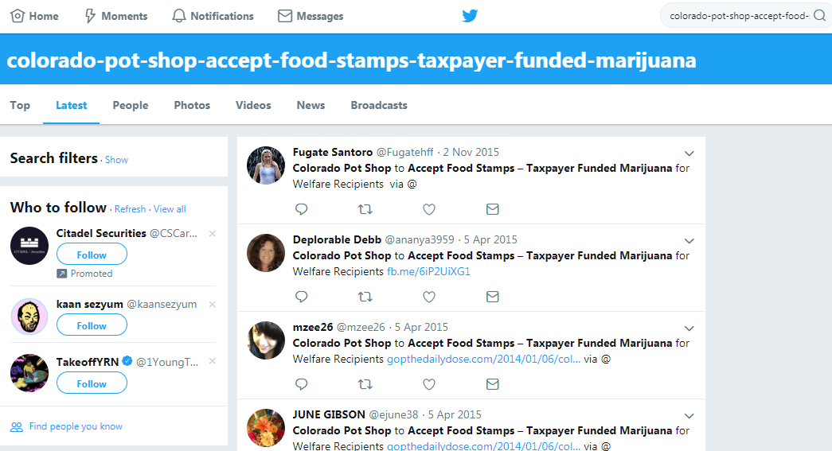
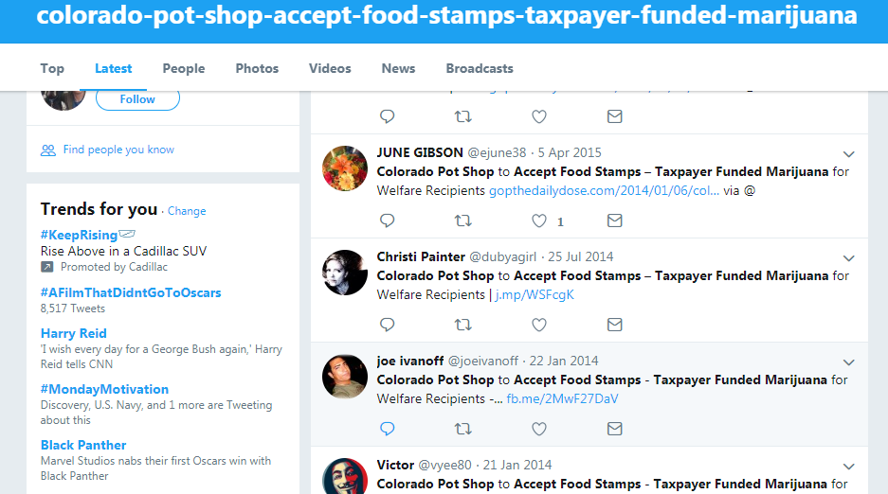
125 tweets over two year period ending 2 Nov 2015
https://twitter.com/search?f=tweets&q=colorado-pot-shop-accept-food-stamps-taxpayer-funded-marijuana&src=typd

Slide 20
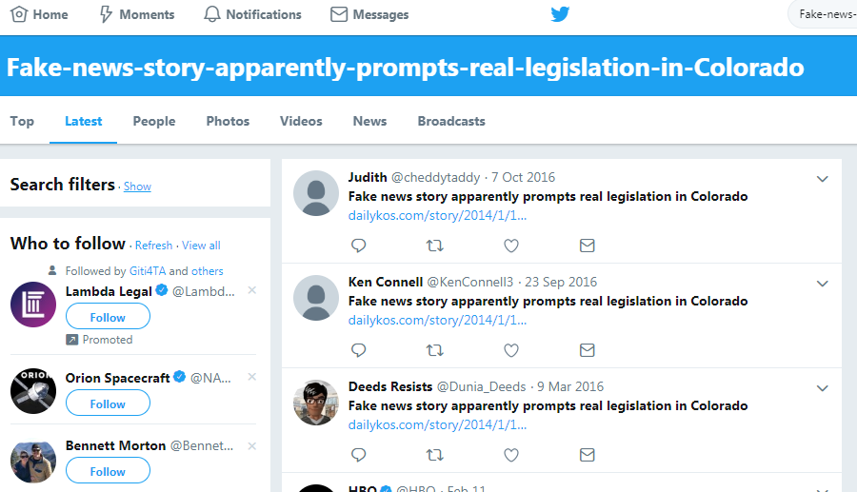
Stopped counting at 200 tweets, Still popping up 2yrs on
https://twitter.com/search?f=tweets&q=Fake-news-story-apparently-prompts-real-legislation-in-Colorado&src=typd

Slide 21
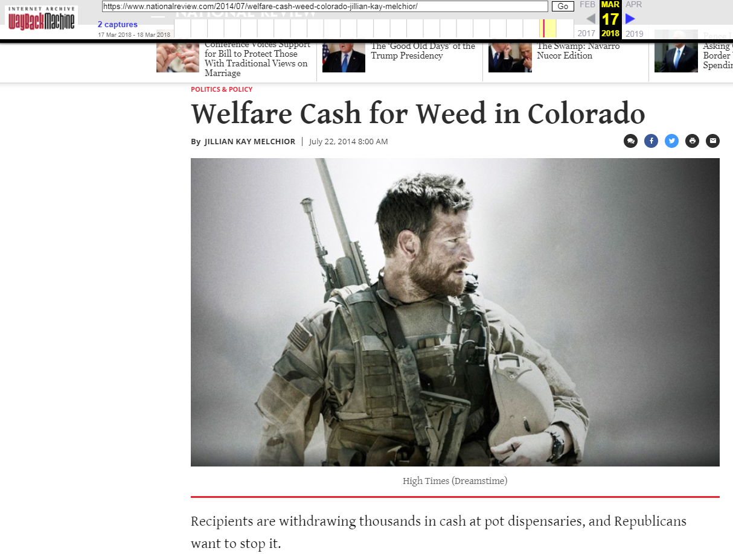
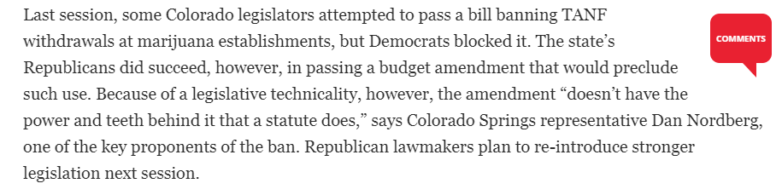
Legislation was not passed that year
https://web.archive.org/web/20180317010151/https://www.nationalreview.com/2014/07/welfare-cash-weed-colorado-jillian-kay-melchior/

Slide 22
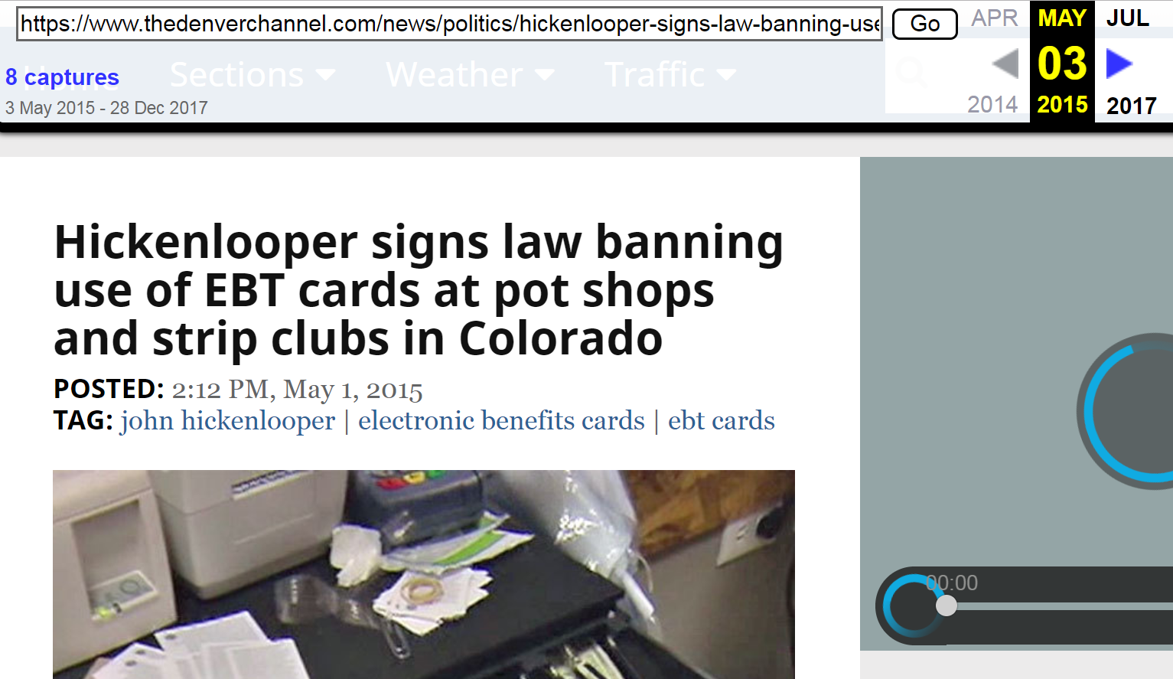
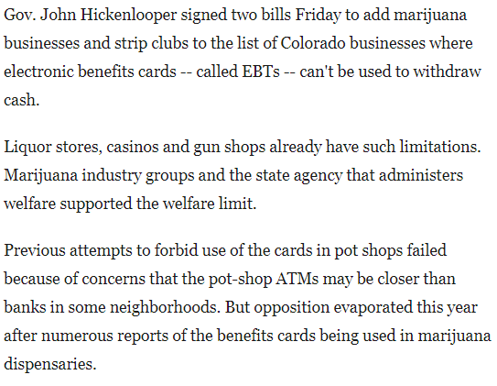
It was passed the following year.
https://web.archive.org/web/20150503231522/https://www.thedenverchannel.com/news/politics/hickenlooper-signs-law-banning-use-of-ebt-cards-at-pot-shops-and-strip-clubs-in-colorado

Slide 23
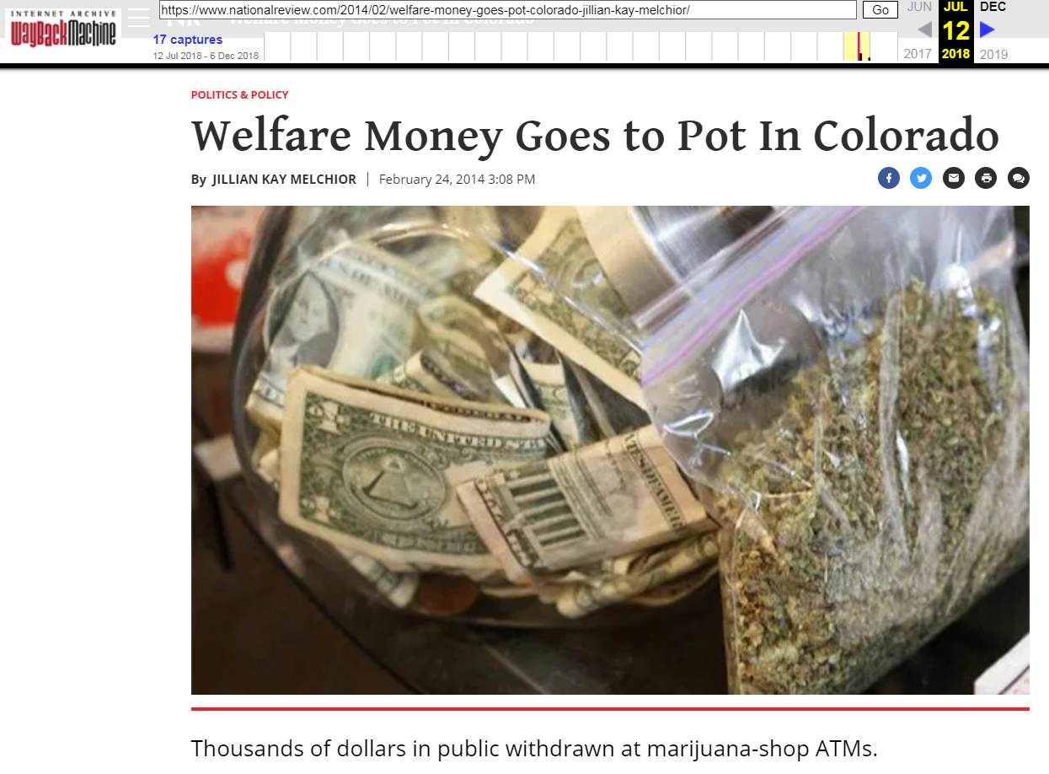
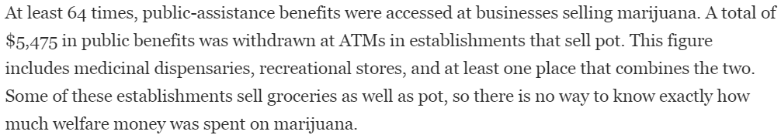
Someone went and looked at actual data
https://web.archive.org/web/20180712103241/https://www.nationalreview.com/2014/02/welfare-money-goes-pot-colorado-jillian-kay-melchior/

Slide 24
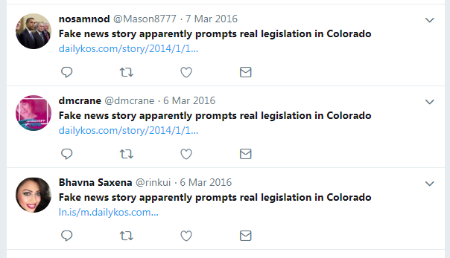
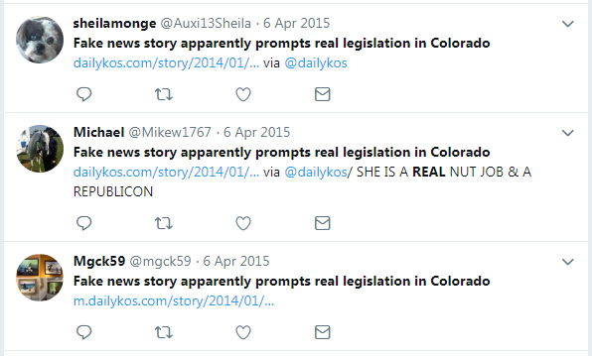
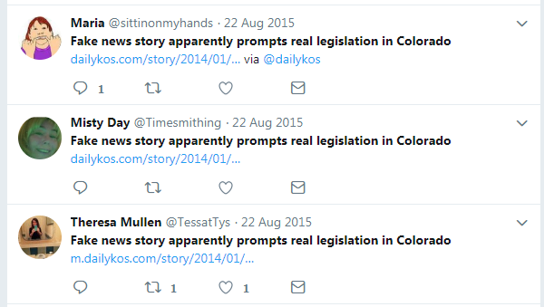
So... what happened?
Initial fake story lost traction when the real story involving ATMs was introduced.
The false story about the fake story continued to make the rounds because nothing better came along.
False False story pops up in a rash of retweets about every 6 months.

Slide 25
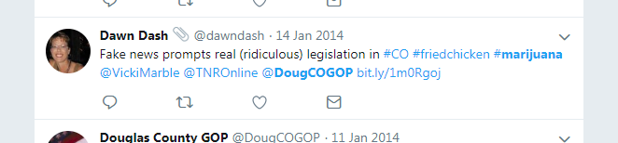
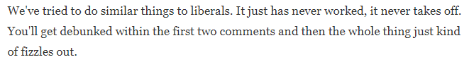
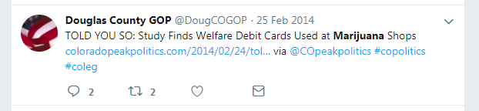
But I really really want it to be true...
Fake news indirectly may have impacted whether legislation passed
Liberals may not be as impervious as implied above. (Taken from NPR interview with Fake News purveyor)
~Jestin Coler
https://www.npr.org/sections/alltechconsidered/2016/11/23/503146770/npr-finds-the-head-of-a-covert-fake-news-operation-in-the-suburbs
https://twitter.com/dawndash/status/423163610802573312
https://twitter.com/DougCOGOP/status/438350935295680512

